Slide 1
Machine Learning

Slide 2
Main Challenges of Machine Learning
Insufficient Quantity of Training Data
Expensive
Hard to Collect
Non representative Dataset
Training set must represent real world observations
Outliers, Poor measurements and Missing Data
Data Cleaning
Most time will be spent here
Irrelevant Features
Garbage in, garbage out
Cannot find required patterns in dataset
Feature Engineering
Overfitting and Underfitting
Bias Variance Tradeoff

Slide 3
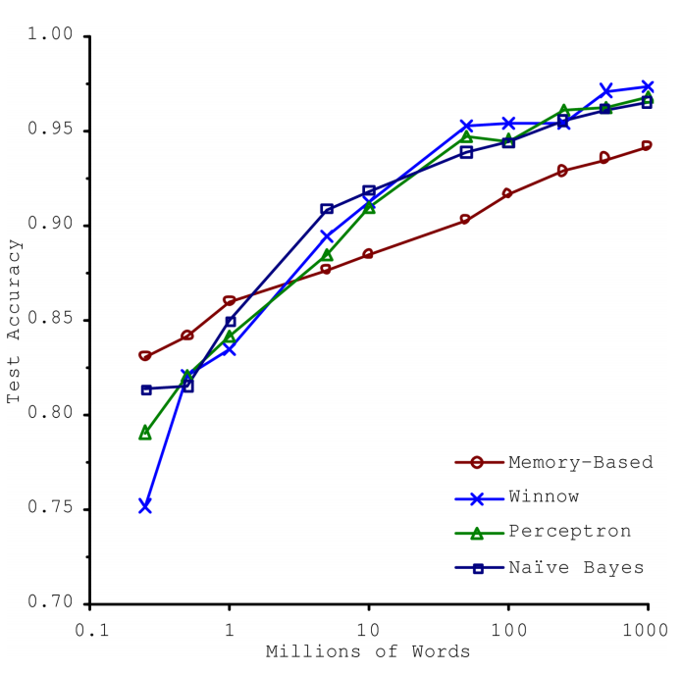

Slide 4
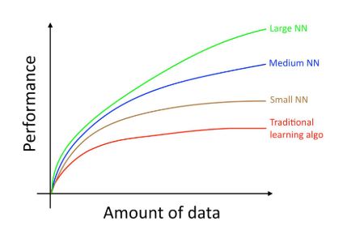

Slide 5
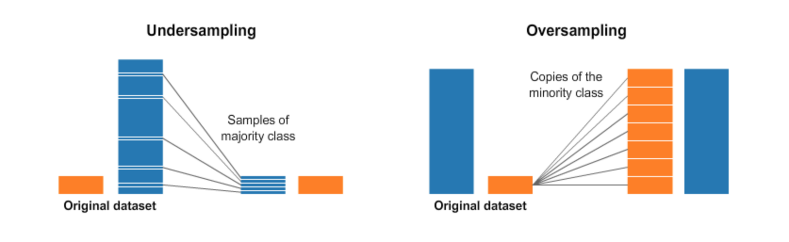

Slide 6
ML Project Lifecycle
Data Gathering
Frame the problem
Regression or Classification
Supervised or Unsupervised
Univariate or Multivariate
Select Performance Measure
Root Mean Square Error
Exploratory Data Analysis
Data Cleaning
Feature Engineering
Train a set of models
Perform Cross validation to select the best model
Estimate Generalization Error on Test set
Deploy Model

Slide 7

Errors in Estimation
Reducible Error
Functional shape of the relationship
Irreducible Error
Missed out some useful predictors
Dependencies between predictors
Random variation

Slide 8
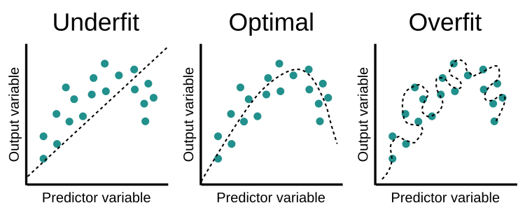
Capacity and Generalization
A model’s capacity is its ability to fit a wide variety of functions.
Capacity controls underfitting and overfitting.

Slide 9
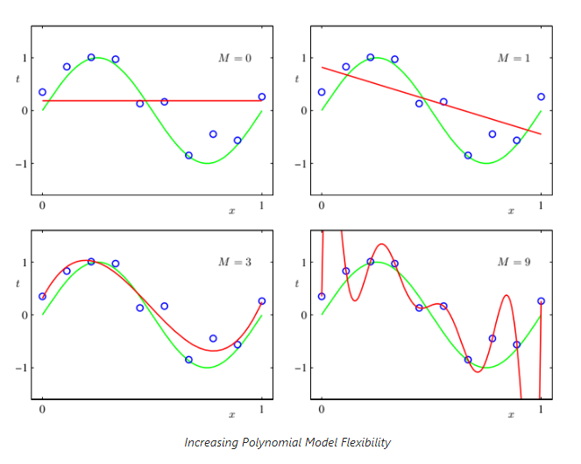

Slide 10
Bias Variance Tradeoff
Ideal Model
Capture all regularities
Generalize well to unseen data
Bias
Inability to capture true relationship between X and Y
Linear Regression
Variance
Sensitivity to small fluctuations in the dataset
Polynomial regression
Large changes in Generalization error
Ideally, both Bias and Variance are low.

Slide 11
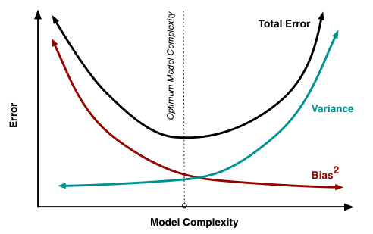
Errors
Training error
Error rate on training dataset
Generalization error
Error rate on test dataset
Training Error < Generalization Error
Overfitting
Training Error > Generalization Error
Underfitting

Slide 12
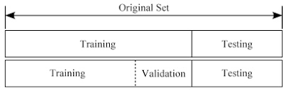
Scenarios
Evaluating one model
Evaluating multiple models
Testing set is
meant for estimating generalization error
not for choosing the best models

Slide 13
Problem
What if we have a small training set?
May not have a sufficiently large Training or Validation set
Training set < Validation set
Unable to learn patterns
Validation set < Training set
Evaluation on validation set will not be accurate
Fix
Cross validation

Slide 14
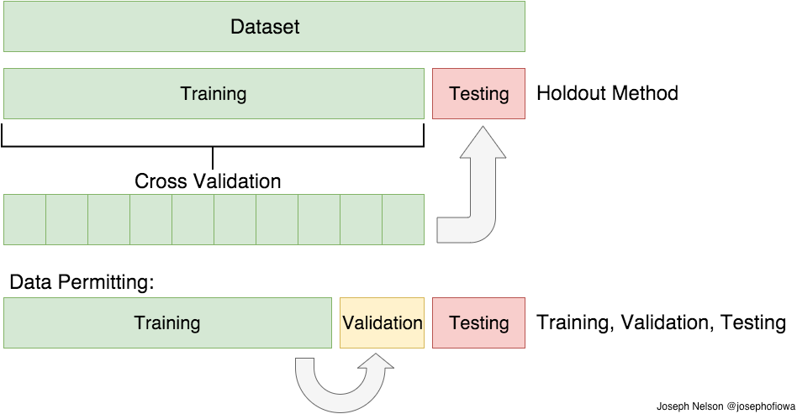
Cross validation
Uses multiple validation sets
Rest of the data is used for training
Take average of evaluation on validation set
Training time is multiplied by number of validation sets

Slide 15
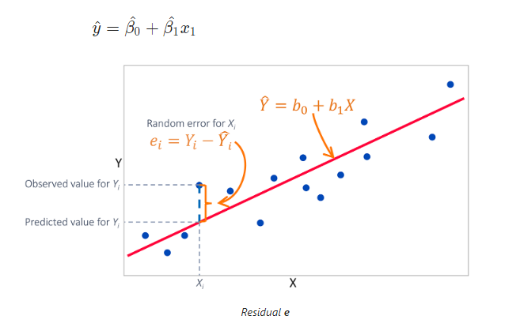
How error is calculated? - Simple Linear Regression
One Predictor X
One Response Y

Slide 16

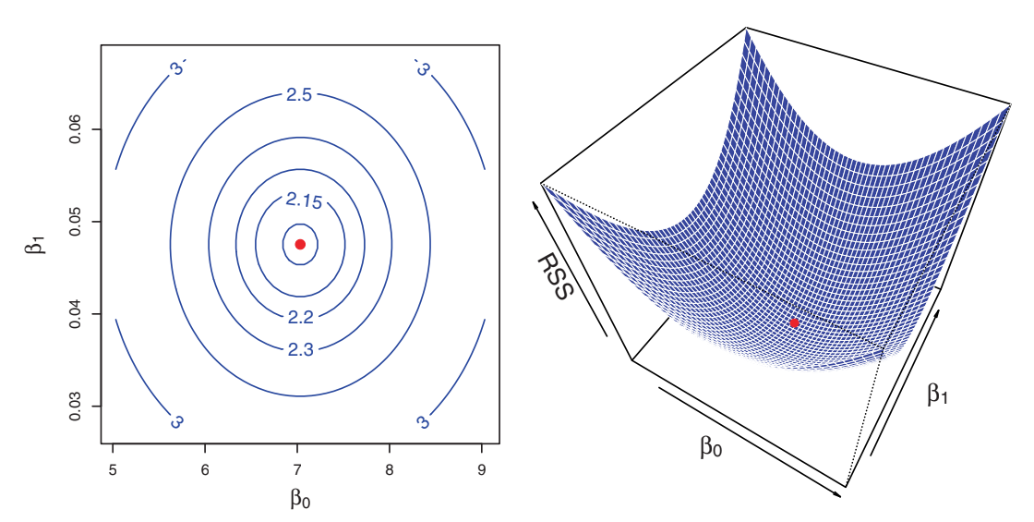

Slide 17
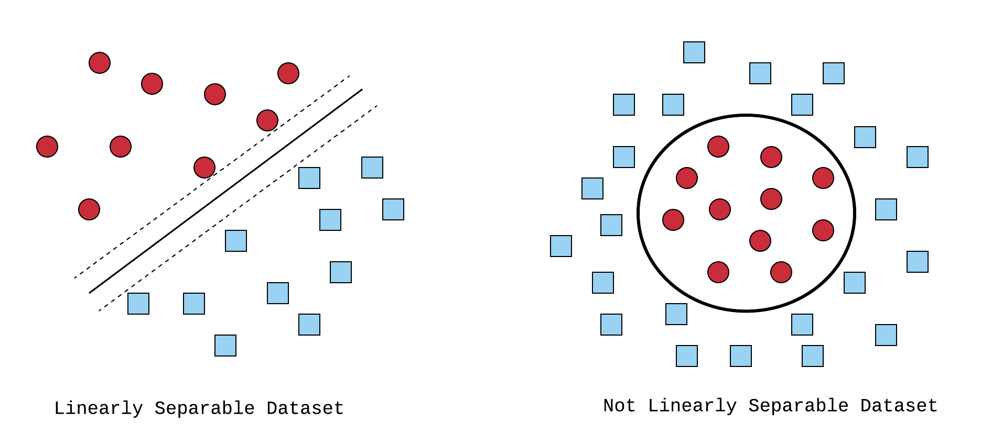
Linearity

Slide 18
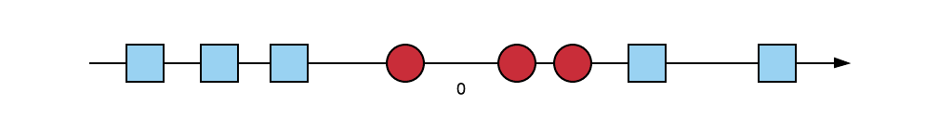
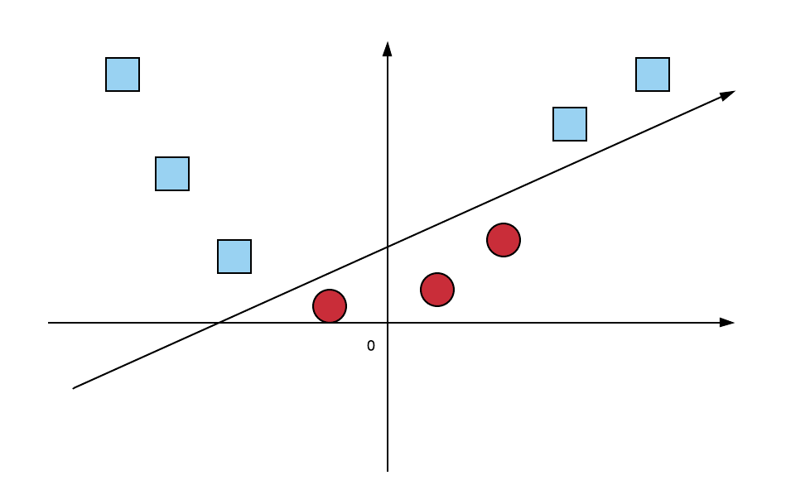
Linearity - Support Vector Machines
1-D Representation
2-D Representation

